Slide 1
REAL-TIME CHAT APPLICATION
A Full Stack Development Project
Presented by:
A.Sumanjali

Slide 2
Introduction
Objective: Build a real-time chat app for instant messaging between users.
Tech Stack:
Frontend: React.js
Backend: Node.js + Express.js
Real-time: Socket.IO
Database: MongoDB

Slide 3
Features
User Authentication (Login/Register)
One-to-One Chat
Real-Time Messaging using WebSockets
Chat History (Stored in DB)
Online User Status
Responsive Design

Slide 4
Architecture Diagram
Include a simple diagram showing:
Client (React)Server
(Node.js + Express + Socket.IO)
Database (MongoDB)
WebSocket Communication Flow

Slide 5
Frontend
Built with React.js
Components:
Login/Register
Chat Window
Contact ListAxios used for REST API calls
Socket.IO client for real-time updates

Slide 6
Backend
Built with Node.js + Express
REST APIs for : Authentication
Fetching messages/users
Socket.IO for real-time messaging
JWT for authentication

Slide 7
Data-Base
Database Design (MongoDB)
Users Collection:
username, email, password Hash
Messages Collection : senderId , receiverId , messageText , timestamp
Chats Collection (optional) : Grouping messages

Slide 8
Screenshots
To create realistic screenshots for the Chat Application, I can generate mockup images showing:
Login/Register Page
Chat List Page (showing contacts)
Chat Window (with real-time messages)
Online User Indicator

Slide 9
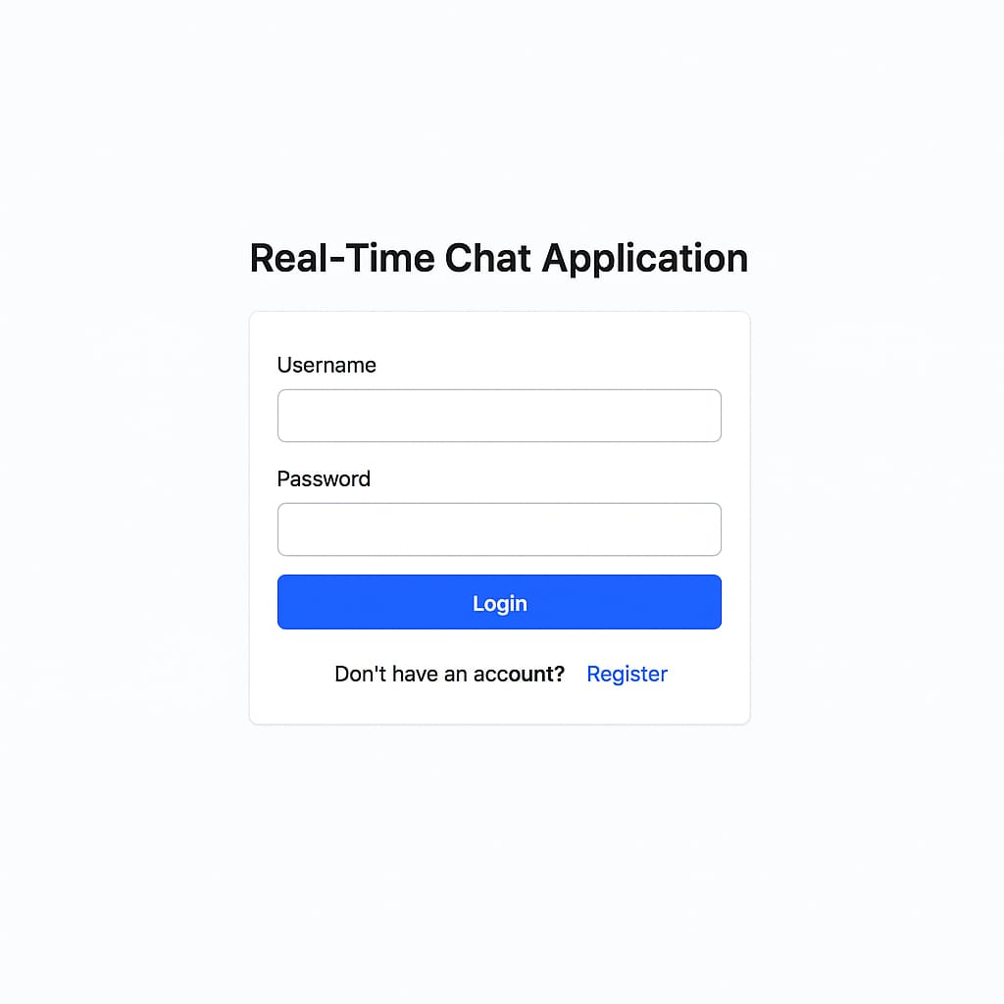
Login/Register Page

Slide 10
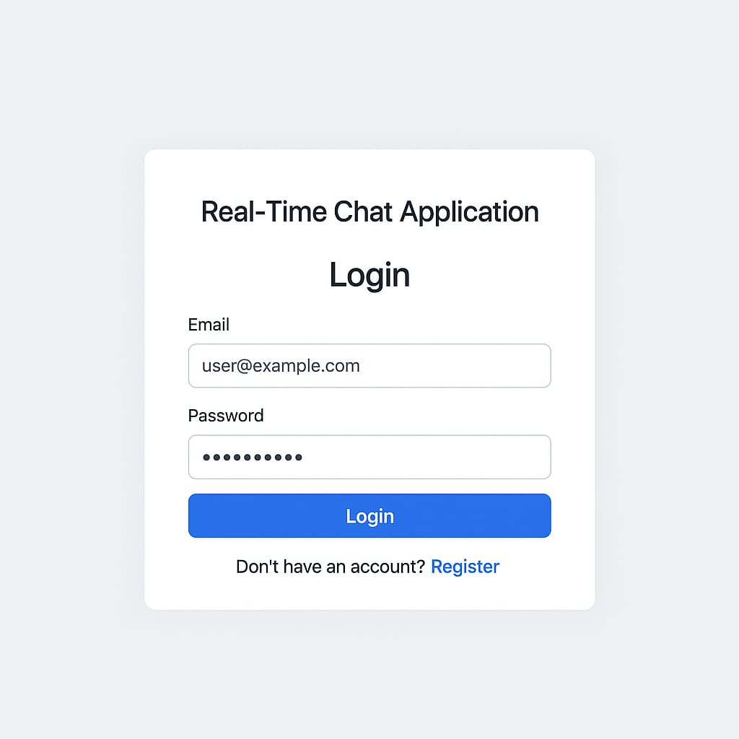
Chat List Page

Slide 11
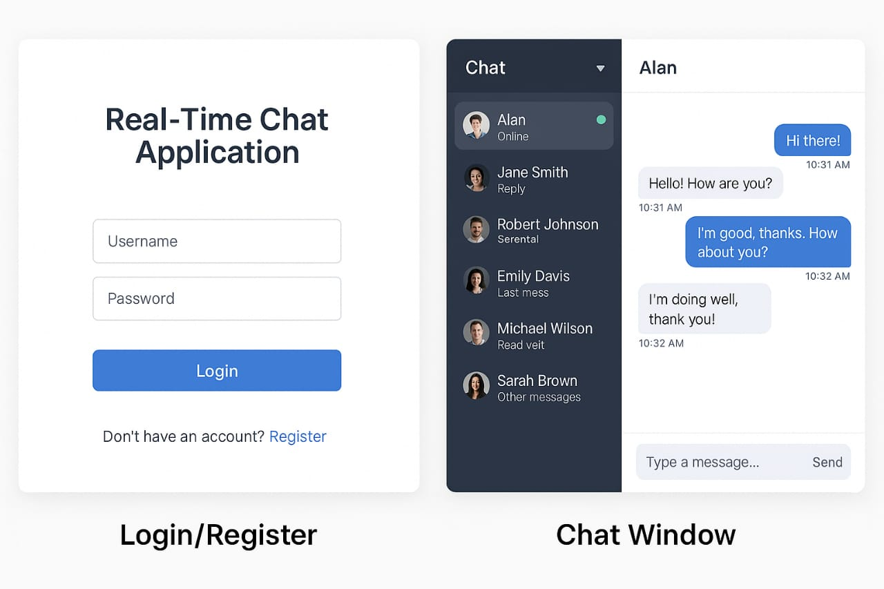
Chat Window(real-time message)

Slide 12
Challenges:
Managing real-time events
Handling concurrent users
Efficient database querying
UI responsiveness

Slide 13
Conclusion
Demonstrated full stack development skills
Learned WebSocket communication
Future improvements : Group Chats,File Sharing
Dark Mode

